Slide 1
GSM

Slide 2

Spectrum Allocation (GSM 900)
Downlink 935 – 960 MHz
Uplink 890 – 915 MHz
200 KHz
890.2
890.6
Uplink
1
1
2
3
4
121
121
122
123
124
890
890.4
915
F (MHz)
935.2
935.6
Downlink
1
121
1
2
3
4
121
122
123
124
935
935.4
960
F (MHz)
GSM 900 Frequency Allocation
ARFCN
Absolute Radio Frequency Channel Number

Slide 3
GSM Radio Subsystem
890-915 MHz => Subscriber to base => Reverse Link
935-960 MHz => Base to Subscriber => Forward Link
Total band = 915 – 890 = 25 MHz
Each 25 MHz Band is divided into 200 KHz channels known as ARFCN

Slide 4
GSM Radio Subsystem
25 MHz/200 KHz = 125 channels are available in total
First 100 KHz and last 100 KHz are used as guard band.
Therefore 124 channels are available for use.

Slide 5
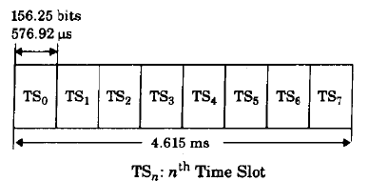
Speech/Dedicated Control Channel Frame
Each channel has 8 timeslots (TS)
Each time slot number within an ARFCN defines a physical channel

Slide 6
GSM Channel Types
Physical VS Logical Channel
Types of Logical Channels
  Traffic channels (TCHs)
    Full Rate => one TS per frame
    Half Rate => one TS in every alternative frames
  Control Channels (CCHs)

Slide 7
GSM Channel Types
  Control Channels (CCHs)
  Broadcast Channel (BCH)
    Broadcast Control Channel (BCCH)
    Frequency Correction Channel (FCCH)
    Synchronization Channel (SCH)
  Common Control Channel (CCCH)
    Paging Channel (PCH)
    Random Access Channel (RACH)
    Access Grant Channel (AGCH)
  Dedicated Control Channel (DCCH)
    Stand-alone Dedicated Control Channel (SDCCH)
    Slow Associated Control Channel (SACCH)
    Fast Associated Control Channel (FACH)

Slide 8
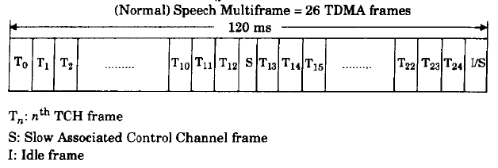
Speech Multiframe
Speech Multiframe = 26 TDMA frames
Frame 13 => SACCH
Frame 26 => If Full Rate TCH, then Idle frame
=> If Half Rate TCH, then SACCH

Slide 9
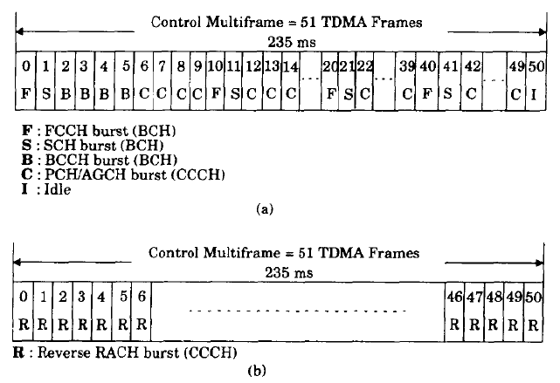
Control Channel Multiframe

Slide 10
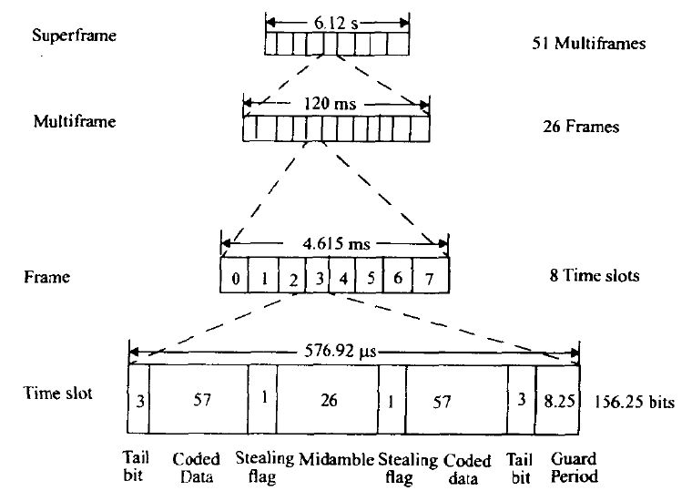

GSM Frame Structure

Slide 11
GSM Frame Structure
1 time slot = 156.25 bit duration = 0.577ms
1 frame = 8 time slots = 4.615 ms
For speech
  1 superframe = 51 multiframes = 6.12s
  1 multiframe = 26 frames = 120ms
For Signaling
  1 superframe = 26 multiframes = 6.12s
  1 multiframe = 51 frames = 235 ms
1 Hyperframe = 2048 superframes (~3.5hr)

Slide 12
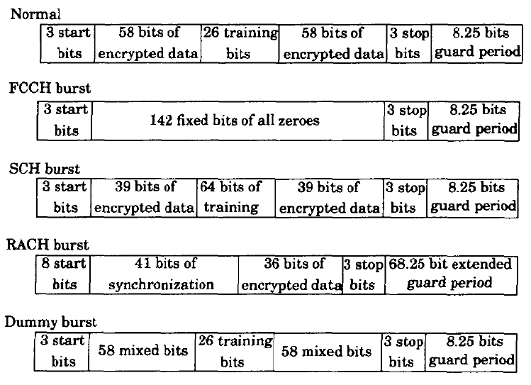
Timeslot data bursts in GSM

